Slide 1



Team Gamma
Marie Newman
Christine Love Johnson
Yoshi Belayneh
Notes:
Marie Newman received her Bachelors of Science from DeBry University and is an alumni from the Keller Graduate School of Management. Marie is currently working in Telecommunications Management.
Christine Love Johnson received her Bachelors of Science from Pacific Lutheran University with an emphasis in Marketing. Christine is currently working in municipal government and is set to begin her Masters program with the University of Arizona in the fall.
Yoshi Balinea received his Bachelors of Business Economics from South Dakota State University and is currently working as a recruiter. In his free time, Yoshi is watching soccer and hopefully he will get back to playing soon.

Slide 2


Determine the next film for Paramount Pictures
Notes:
Andrew Gumpert, COO of Paramount Pictures, hired us to determine what the next movie Paramount Pictures should produced based on genre and rating.
The team utilized data from IMDB, the Numbers and Rotten Tomatoes to make our recommendations.
Now Yoshi will explain the combination of the databases.

Slide 3
Combining databases using SQL
Identified key fields from IMDB and the Numbers databases.
Joined databases using SQL
Notes:
We first uploaded the IMDB datasets to DB Browser. After making some sql calls to understand the datasets, we went on to gather additional data from outside sources.
We decided to get the additional datasets we needed from the numbers website, and Rotten tomatoes as they were easily accessible.
We cleaned the data we gathered from the numbers website and rotten tomatoes (meaning we had to make some changes to headers to match what we already have in the IMDB dataset) and then imported the datasets as a CSV file using the DB browser. After getting familiar with all the datasets we have on hand, we wrote some sql calls to and joined the tables.
The fields we identified: Year, Genre, runtime, production budget, domestic box office, number of votes and average rating. We also limited the scope to movies made from 1980 through 2020. The tables we joined were the basics and ratings table. Joining them on t construct.
The initial JOIN sql calls we made were based on just IMDB datasets only and joining the basics and ratings tables with the scope of moves made in 1980 - 2020 and that resulted in nearly 200K rows.
We then joined the data we got from the numbers website and added some conditional statements to limit the scope and that resulted in 137 rows. This iteration was baed on PG13 data only and resulted in 137 rows of data, which when the duplicates were removed, results were reduced to 88 rows.
The data was re-ran including rated R and PG which each resulted in 88 rows.
We also ran the data including PG13 and initially came up with 88 rows, but had some duplicated data so we had to use a conditional statement to get rid of duplicates and it resulted in 47 rows.
We then had to clean the data some more, removing duplicates using excel. After that we took our final dataset to Orange.
Now Marie will take you through the initial visualization process.

Slide 4
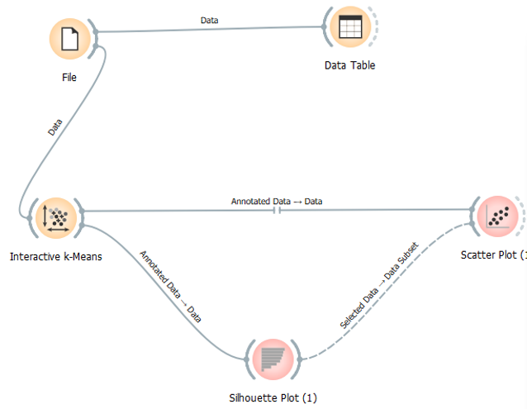
Loading the cleaned data into Orange
Notes:
Started with 194,782 rows.

Slide 5
Visualization Tools
Unsupervised learning tools: interactive k-means, silhouette plot and scatterplot with linear regression
Supervised learning tools: Random Forests

Slide 6
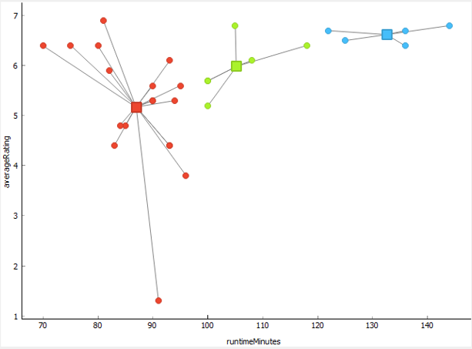
Interactive k-Means
Notes:
Variables: runtime in minutes and average rating
** be prepared to explain why you choose K

Slide 7
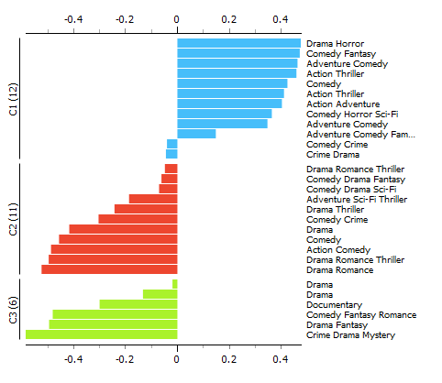
Silhouette Plot
Notes:
Summarized the clusters that were close and away from each other.
Add something regarding the positive vs the negative

Slide 8

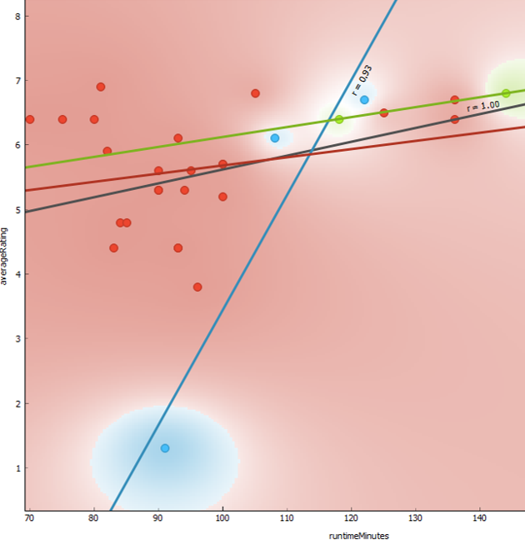
Scatter Plot
Regression lines with Rho numbers per cluster:
C1: r = 0.93
Runtime minutes: between 70 and 136
Average rating: 6.4 to 6.8 out of 10
Genres: Drama, Documentary, Drama, Crime Drama Mystery and Drama Fantasy
C2: r = 0.25
Runtime minutes: between 70 to 136
Average rating: 1.3 to 6.9 out of 10
Genres: Adventure Comedy, Comedy Crime, Comedy, Drama Thriller, Drama, Comedy Drama Fantasy, Comedy Crime, Action Adventure, Adventure Sci-Fi Thriller
C3: r = 0.100
Runtime minutes: between 118 and 144
Average rating: between 6.4 and 6.8
Genres: Comedy Fantasy, Comedy Horror Sci-Fi, Crime Drama, Comedy Fantasy Romance
Notes:
** Add note that we re-ran this process using number of votes and average rating and determined that votes between 56447 and 84102 with ratings of 6.4 and 6.8 were most popular
And now Christine will talk about Supervised learning….

Slide 9
Decision Tree using IMDB
Action
Adventure
Comedy
Profitable
Profitable
Not Profitable
Not Popular
Popular
Genre
Notes:
Using the data from IMDB, I was able to categorize the data based on three main features: Profitability, Popularity and Genre of movies released between 1980 and 2020.
In order to determine the profitability of a movie, I calculated the adjusted budget for the film and doubled that number to create the breakeven point. I then took the difference between the worldwide box office totals. If the result was a positive number, it was categorized as profitable. Any films where the budget was larger than the worldwide box office totals was determined to be Not Profitable.
The popularity of the film was determined by using the calculated vote average from IMDT. Any movie with an average score higher than 6.0 was determined to be popular amongst the raters of IMDT.
These results were then categorized into different genre. The genre which demonstrated a strong profitability rating, and viewer popularity rating over the 40-year trend was determined to be the best recommendation for the next movie to be produced by Paramount Pictures.

Slide 10
Decision Tree using Rotten Tomatoes
Action
Adventure
Comedy
Profitable
Profitable
Not Profitable
Not Popular
Popular
Genre
Notes:
It was important to run the same decision tree process using data from Rotten Tomatoes. Rotten Tomatoes, is another site similar to IMDb but with a much different rating system. Rotten Tomatoes uses reviews from approved critics and publication to determine a score between 1 and 100, with a top score rating between 75 to 100. Although it is currently unsubstantiated by Rotten Tomatoes, there does appear to be a bias towards films with a large number of positive reviews.
The top-rated movie according to Rotten Tomatoes would be an Art House or Documentary style movie. It was determined that due to emphasis placed on the critic’s reviews verse the general viewer, Rotten Tomatoes is not a good measure on profitability of a movie genre.

Slide 11
Recommendations:
Rating:
PG-13
Run time between: 110 – 125 min.
Drama

Slide 12
Git Hub
https://github.com/yoshibelayneh/Team-Gamma-WA-DABootcamp
Notes:
If you would like to get more information on our project, visit our team’s Git Hub site. Information will be posted in the next 48 hours.

